Slide 1
Thesis Meeting
18/11/2022

Slide 2
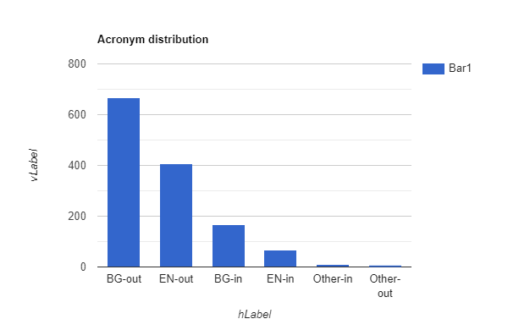
Stats for data
BG-out 666
EN-out 406
BG-in 168
EN-in 66
Other-in 9
Other-out 7

Slide 3
Results
SDU AAAI AI - Dataset
Algorithm | Acronyms in text |  |  | Expansions in text |  |  | Pairs in text |  |  | Dict Acronyms |  |  | Dict Pairs |  |  | Execution Times
Schwartz-Hearst | 0.960206 | 0.823641 | 0.886696 | 0.966999 | 0.79646 | 0.873484 | 0.928519 | 0.79646 | 0.857435 | 0.947988 | 0.826347 | 0.882998 | 0.910697 | 0.793841 | 0.848263 | 0.000026 | 0.000104
MADDOG | 0.986341 | 0.867257 | 0.922973 | 0.982507 | 0.852086 | 0.912661 | 0.969087 | 0.852086 | 0.906828 | 0.984329 | 0.859709 | 0.917808 | 0.963761 | 0.841745 | 0.89863 | 0.1605 | 0.007975
Iliya | 0.920052 | 0.887484 | 0.903475 | 0.982194 | 0.87168 | 0.923644 | 0.90367 | 0.871681 | 0.887387 | 0.912343 | 0.872541 | 0.891998 | 0.889982 | 0.851155 | 0.870136 | 0.00002 | 0.001277
Iliya (v1.1) | 0.919283 | 0.90708 | 0.91314 | 0.9777 | 0.886852 | 0.930063 | 0.898783 | 0.886852 | 0.892778 | 0.906331 | 0.893926 | 0.900086 | 0.882047 | 0.869974 | 0.875969 | 0.00003 | 0.000543
 | Precision | Recall | F1-Measure | Precision | Recall | F1-Measure | Precision | Recall | F1-Measure | Precision | Recall | F1-Measure | Precision | Recall | F1-Measure | per model | per article
Wiki user- Dataset
Algorithm | Acronyms in text |  |  | Expansions in text |  |  | Pairs in text |  |  | Dict Acronyms |  |  | Dict Pairs |  |  | Execution Times
Schwartz-Hearst | 0.91 | 0.705426 | 0.79476 | 0.945055 | 0.666667 | 0.781818 | 0.86 | 0.666667 | 0.751092 | 0.904255 | 0.708333 | 0.794393 | 0.851064 | 0.666667 | 0.747664 | 0.000028 | 0.000465
MADDOG | 0.927835 | 0.697674 | 0.79646 | 0.955556 | 0.666667 | 0.785388 | 0.886598 | 0.666667 | 0.761062 | 0.922222 | 0.691667 | 0.790476 | 0.877778 | 0.658333 | 0.752381 | 0.190727 | 0.086684
Iliya | 0.865169 | 0.596899 | 0.706422 | 0.987013 | 0.589147 | 0.737864 | 0.853933 | 0.589147 | 0.697248 | 0.86747 | 0.6 | 0.70936 | 0.84337 | 0.583333 | 0.689655 | 0.000028 | 0.021245
Iliya(v1.1) | 0.801802 | 0.689922 | 0.741667 | 0.966292 | 0.666667 | 0.7889 | 0.774775 | 0.666667 | 0.716667 | 0.769231 | 0.7 | 0.75 | 0.769231 | 0.666667 | 0.714286 | 0.000021 | 0.012437
 | Precision | Recall | F1-Measure | Precision | Recall | F1-Measure | Precision | Recall | F1-Measure | Precision | Recall | F1-Measure | Precision | Recall | F1-Measure | per model | per article
Medstract - Dataset
Algorithm | Acronyms in text |  |  | Expansions in text |  |  | Pairs in text |  |  | Dict Acronyms |  |  | Dict Pairs |  |  | Execution Times
Schwartz-Hearst | 1 | 0.891304 | 0.79476 | 1 | 0.891304 | 0.781818 | 1 | 0.666667 | 0.751092 | 1 | 0.708333 | 0.794393 | 1 | 0.666667 | 0.747664 | 0.000033 | 0.000339
Iliya | 1 | 0.318182 | 0.482759 | 0.642857 | 0.204545 | 0.310345 | 0.642857 | 0.204545 | 0.310345 | 1 | 0.333333 | 0.5 | 0.642857 | 0.214286 | 0.321429 | 0.000033 | 0.007173
Iliya(v1.1) | 0.958333 | 0.5 | 0.657143 | 0.73913 | 0.369565 | 0.492754 | 0.708333 | 0.369565 | 0.485714 | 0.956522 | 0.5 | 0.656716 | 0.695652 | 0.363636 | 0.477612 | 0.000021 | 0.006975
 | Precision | Recall | F1-Measure | Precision | Recall | F1-Measure | Precision | Recall | F1-Measure | Precision | Recall | F1-Measure | Precision | Recall | F1-Measure | per model | per article

